Slide 1
Inheritance

Slide 2
Definition
Teacher
Keyword to denote inheritance
HOD
public class HOD extends Teacher{
Features of Teacher class automatically available.
add additional members
}

Slide 3
Inheritance defined
Inheritance is an object oriented concept that allows hierarchical classifications. Using this concept, a general class can be created that defines traits common to a set of related items. This class can then be inherited by more specific classes with each adding those things that are unique to it.
The class that is inherited is called super class and the class that is inheriting is called a subclass.

Slide 4
Members that are not accessible
Super class members which cannot be accessed
-- Private members
-- Default members (if subclasses are in the different packages).
HOD class cannot access factId, name or the static variable id since they are private but can access most of the methods of Faculty since they are public

Slide 5
package teacher;
public class HOD extends Teacher{
private String dateOfAppointment;
public HOD(String nm, String dt){
super(nm);
dateOfAppointment=dt; }
public void viewGrade(Grade[] grades){
System.out.println(getName()+ " HOD viewing appraisal ");
for(Grade g:grades){
System.out.println("Faculty :"+ g.getFaculty().getName());
Calling super class constructor
Calling super class method

Slide 6
System.out.println("Student ID : "+ g.getStudent().getRegNo());
System.out.println("Grade: "+ g.getGrade());
}
}
public static void main(String str[]){
student.Student s1= new student.Student("Ravi");
student.Student s2= new student.Student(“Kumar");
HOD h=new HOD("Maverick","1.1.2006");
Teacher f= new Teacher("Sam");

Slide 7
Grade g[]=new Grade[2];
g[0]=new Grade(f,s1,"CS-001", Grade.A);
g[1]=new Grade(f,s2,"CS-001", Grade.B);
h.viewGrade(g);
}
}

Slide 8
super
Keyword super() is used to call the super class constructor.
public HOD(String nm, String dt){
super(nm);//calls Teacher(String name)
}
It can also be used to invoke super class methods from the subclass method.
super.getFactId();
/* calls Teacher class’ getFactId() method if invoked from a method of HOD.*/
First statement in the constructor

Slide 9
public HOD(String nm, String dt){
//super(nm); dateOfAppointment=dt;
}
…}
On compilation
Compilation error: cannot resolve symbol constructor Teacher()

Slide 10
What is happening ?
public HOD(String nm, String dt){
//super(nm); dateOfAppointment=dt; }
..}
Compiler inserts
super();
Attempting to call
Teacher()
And since there is no Teacher() constructor, an error is generated.

Slide 11
Order of initializations when subclass instance is created
class Order {
int i;
static {
System.out.println("Order class static block ");
}
Order(){
i=10;
System.out.println("Order class constructor,i= " + i);
}
{
System.out.println("Order class instance block,i= " + i);
}
}

Slide 12
class SubOrder extends Order{
int j=9;
static {
System.out.println("SubOrder class static block");
}
SubOrder(){
j=15;
System.out.println("SubOrder class constructor,j= "+ j);
}
{
System.out.println("SubOrder class instance block,j= " + j);
}
public static void main(String str[]){
new SubOrder(); }}

Slide 13
And this is the result of executing the code…
Order class static block
SubOrder class static block
Order class instance block,i= 0
Order class constructor,i= 10
SubOrder class instance block,j= 9
SubOrder class constructor,j= 15

Slide 14
protected access
Protected access specifier for a member of class A allows access to the members of the classes in the same package as class A (same as default access specifier)
+
allows access to the members of the child classes of class A which are in different package.

Slide 15
Subclass outside the package
(Java Language Specification)
6.6.2 Details on protected Access
A protected member or constructor of an object may be accessed from outside the package in which it is declared only by code that is responsible for the implementation of that object.
6.6.2.1 Access to a protected Member
Let C be the class in which a protected member m is declared. Access is permitted only within the body of a subclass S of C. In addition, if Id denotes an instance field or instance method, then: If the access is by a qualified name Q.Id, where Q is an ExpressionName, then the access is permitted if and only if the type of the expression Q is S or a subclass of S. If the access is by a field access expression E.Id, where E is a Primary expression, or by a method invocation expression E.Id(. . .), where E is a Primary expression, then the access is permitted if and only if the type of E is S or a subclass of S.

Slide 16
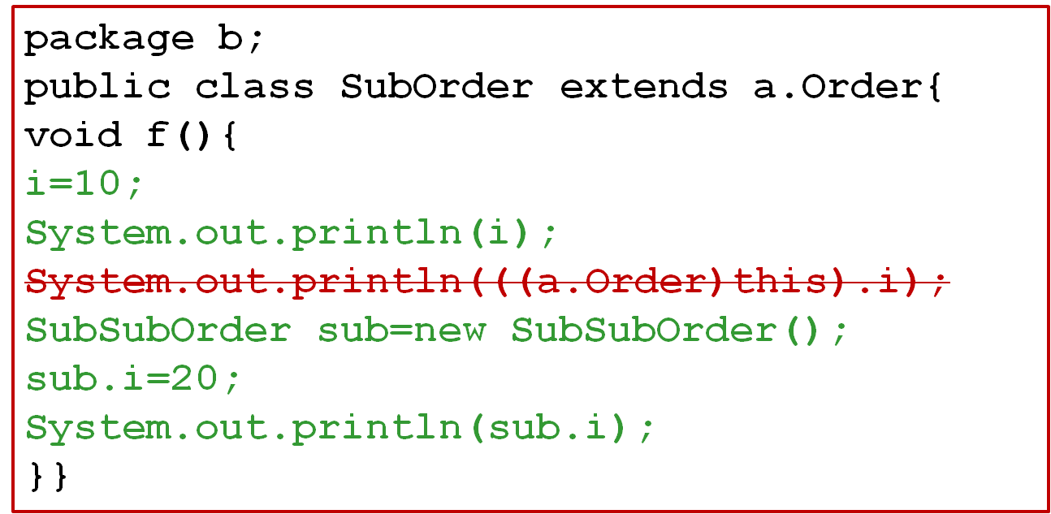
package a;
public class Order {
protected int i;
}}
SubSubOrder

Slide 17
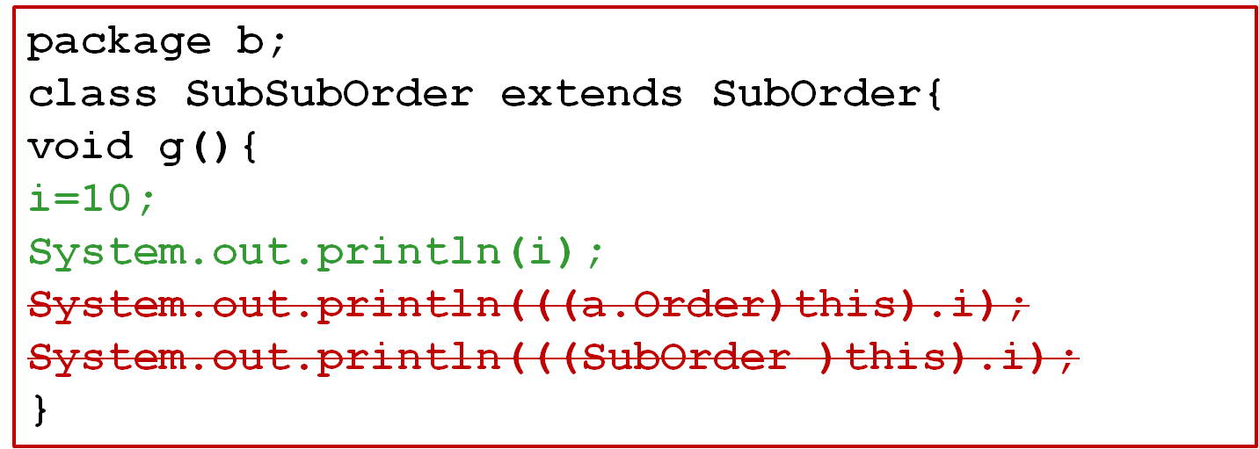
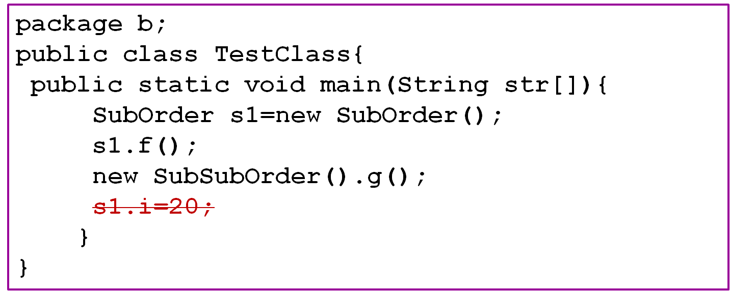

Slide 18
Conversion and casting
A subclass object reference can be converted to super class object reference automatically.
But for vice versa, casting is required.
Example:
Teacher f= new HOD();
f.getFactId(); //ok
f.viewGrade(); //error
// But if we cast it back to HOD it’s ok
HOD h=(HOD) f;
h.viewGrade(); //ok
But HOD h= (HOD) new Teacher(“x”));
h.viewGrade();
Automatic conversion.
Only members of Teacher class are accessible
Casting
Runtime error-
ClassCastException

Slide 19
Overriding
Redefinition of an inherited method declared in the super class by the subclass is called Overriding.
When we redefine a method we have some flexibility in terms of not having exactly same method declaration as the super class method.

Slide 20
Rules
The signature of the method( method name + argument list) must exactly match.
The return type must be same or a subtype of the return type of super class method (covariant returns)
The access can be same or be increased.
(List of access specifiers in order of their increasing accessibility: private→default→protected→public)
Instance methods can be overridden only if they are inherited/visible by the subclass.
Exception thrown cannot be new exceptions or parent class exception.
We will deal with this later.

Slide 21
Covariant Returns
The overridden method’s return type can also be a subtype of the original method return class’ subtype.
For example:
  public class Teacher{
  public Teacher getInstance(){
  return new Teacher();}
  }
  public class HOD extends Teacher{
  public HOD getInstance(){
  return new HOD();}}

Slide 22
Access specifier rule
package teacher;
public class Teacher{
..
protected void display(){
System.out.println(
"Name "+getName());
System.out.println("ID :"+factId) ;
}
}
package admin;
public class HOD extends Teacher{
..
public void display(){
super.display();
System.out.println(
"Date of appointment "+dateOfAppointment);
}
}
Cannot have private or default access specifier

Slide 23
Visibility rule
package admin;
public class HOD extends Teacher{
..
public void display(){
System.out.println(
"Name "+getName()); System.out.println(
"Date of appointment "+dateOfAppointment);
}
}
package teacher;
public class Teacher{
..
private void display(){
System.out.println(
"Name "+getFirstName())
System.out.println("ID :"+factId) ;
}
}
Can have any access specifier here. Since private methods are not inherited !

Slide 24
Polymorphism
In practice, it refers to an object’s ability to use a single method name to invoke one of different methods at run time – depending on where it is in the inheritance hierarchy.
What this means is …

Slide 25
Polymorphism
public static void print(Teacher f[]){
for(int j=0;j<f.length;j++)
f[j].display();
}
public static void main(String str[]){
Teacher f[]=new Teacher[2];
f[0]=new HOD(“Ned”,”1.1.2006”);
f[1]=new Teacher(“Sam”);
print(f);}

Slide 26
HOD’s display()
Output:
Name :Ned
ID :1
Date of appointment 1.1.2006
Name :Sam
ID :2
Teacher’s display()
The key to making polymorphism work is late binding/ dynamic binding. The compiler does not generate code to call a method at compile time. Instead compile calculates based on the object type which method to call only at the run time.

Slide 27

Private method re-declaration
What happens if you re-declare a private method in your subclass? Can we still expect a polymorphic behavior?
Since the private methods are not inherited they are not overridden.
Since they are not overridden there is no polymorphic behavior.

Slide 28
public class A{
System.out.println("in A:f()");
}
public static void main(String str[]){
A a= new B();
a.f();
}}
class B extends A{
public void f(){
System.out.println("in B:f()");
}}
protected void f(){
What will the code print?

Slide 29
public class A{
System.out.println("in A:f()");
}
public static void main(String str[]){
A a= new B();
a.f();
}}
class B extends A{
public void f(){
System.out.println("in B:f()");
}}
private void f(){
What if we change protected as private for f() in class A

Slide 30
Static member re-declaration
class ClassRoom{
static int capacity=50;
public static void printCapacity(){
System.out.println("Class Room seating capacity "+ capacity); }}
class SeminarHall extends ClassRoom{
static int capacity =500;
public static void printCapacity(){
System.out.println("Seminar Hall seating capacity "+ capacity); }

Slide 31
public static void main(String str[]){ ClassRoom examHall= new SeminarHall ();
examHall.printCapacity();
}
}
ClassRoom’s method
Prints :Class Room seating capacity 50.
Even though examHall1 refers to SeminarHall object, call to the static method calls only the super class ClassRoom’s method.
So we find that static methods are not polymorphic

Slide 32
Hiding .Vs. Overriding
Are static methods overridden?
Answer is No!
A method is said to be overridden only if it can take the advantage of runtime polymorphism!.
Otherwise it is only hidden.
So the static methods of the super class are hidden when they redefined in the sub class.
The static methods of the super class cannot be redefined as non-static method in subclass or vice-versa.

Slide 33
Member variable re-declaration
package teacher;
public class Teacher{
…
public String achievements;
}}
package admin;
import teacher.*;
public class HOD extends Teacher{
…
public String achievements;

Slide 34
public static void main(String str[]){
HOD h=new HOD("Maverick","1.1.2006");
h.achievements="Best HOD";
Teacher f=h;
f.achievements="Best Faculty";
System.out.println( h.achievements);
System.out.println( f.achievements);
}
}
Output: Best HOD
Best Faculty
Both Teacher and the HOD classes have their own copies of achievements member variable.

Slide 35
final Revisited
A method that is declared as final prevents an inheriting class from overriding that method.
A class that is declared as final prevents other classes from inheriting from it.
String class and all the wrapper classes (Boolean, Double, Integer etc.etc.) are final.

Slide 36
package student;
public class Grade{
public final String getGrade(){
…
}}
public class MyGrade extends Grade{
public final String getGrade(){
…
}}
Compilation error

Slide 37
package student;
public final class Grade{
…
}}
Compilation error
package student;
public class MyGrade extends Grade{
…
}}

Slide 38
Abstract class
Declaring a class as an abstract class prevents somebody from creating instances of that class.
An abstract class can have abstract methods.
Abstract methods are the methods that don’t have the method body. They are just declarations.
Any class that inherits from the abstract class must override all the abstract methods and provide implementations specific to that class.
A class that does not override an abstract method must be marked as an abstract class.

Slide 39
Each person must have a unique id.
Teacher
Person
<<abstract>>
…
getUID()
getName()..
getAddress()..
<<abstract >>
getUID()
Student
…
getUID()
new Person()
Since the implementation of id is dependent on the individual classes, we make the getUID() method abstract.

Slide 40
package general;
public abstract class Person{
private String name;
private String address;
protected Person(){}
public void setName(String name){
if(name==null)
System.out.println("Invalid name");
else
this.name=name;
}
public String getName(){
return name;}

Slide 41
public void setAddress(String address){
if(address==null)
System.out.println("Invalid name");
else
this.address=address;}
public String getAddress(){return address;}
public abstract int getUID();
public Person(String name, String address){
setName(name); setAddress(address);}
public Person(String name){
setName(name);
}
}
Two more constructors added for convenience.

Slide 42
package student;
public class Student extends general.Person{
//remove getters and setter for name attribute
public int getUID(){return regNo;}
public Student(String nm, String d){
super(nm);
…}}
Abstract method implemented
package teacher;
public class Teacher extends general.Person{
//remove getters and setter for name attribute
public int getUID(){return factId;}
etc…}

Slide 43
Object
All classes in java by default inherit from a predefined class Object.
java.lang.Object
Concrete class
general.Person
teacher.Teacher
student.Student
teacher.HOD
Notes:
.

Slide 44
Object
Two important methods:
public String toString()
public boolean equals(Object obj)

Slide 45
Printing an object reference
import teacher.*;
public class Test{
public static void main(String str[]){
Teacher f=new Teacher ("Tom");
System.out.println(f);
}}
Prints : teacher.Teacher@f4a24a
toString() method of the Object class is called

Slide 46
Overriding toString()
package teacher;
public class Teacher{
…
public String toString(){
return getName()+" (" +factId+ ")";
}
}
import teacher.*;
public class Test{
public static void main(String str[]){
Teacher f=new Teacher ("Tom");
System.out.println(f);
}}
Prints : Tom (1)

Slide 47
Overriding equals()
equals() method of Object class compares two references using == operator.
== operator compares the addresses!
To compare the equality of two objects in terms of its member variables we need to override the equals method to suit our need.
public boolean equals(Object o)

Slide 48
Overriding equals()
package student;
public class Grade{
public boolean equals(Object o){
Grade g=(Grade)o;
if (g.getGrade().equals(getGrade()))
return true;
else
return false;}
…}
Note that string class has overridden the equals method so we get the desired result here

Slide 49
import student.*;
class Test{
public static void main(String str[]){
Grade g=new Grade(new Student("Raja"),new int[]{ 80,85, 91,86, 82});
Grade g1=new Grade(new Student("Rani"),new int[]{ 90,70, 89,78, 92});
if(g.equals(g1))
System.out.println("Same");
else
System.out.println("Differnt");
}
} }}

Slide 50
instanceof
Usage:
object-ref instanceof class-name/interface-name
returns a boolean value.
Example:
Student s1= new Student(“Mary”);
System.out.println(s1 instanceof Student);
System.out.println(s1 instanceof Person);
System.out.println(s1 instanceof College);
System.out.println(s1 instanceof Teacher);
later
true
Compilation error: inconvertible types

Slide 51
Person s1= new Student(“Mary”);
System.out.println(s1 instanceof Teacher );
false
System.out.println(null instanceof Student);

Slide 52
Exercise to understand inheritance and polymorphism
Create a class called Circle with attribute radius. Ensure appropriate constructors. Have methods to get diameter, area(PI* raduis²)and circumference( 2*PI*radius). Override equals() and toString() methods.
Create another class called Sphere that inherits from Circle. Override area (4 * raduis² *PI); and add another method called volume (4 * PI * raduis³ / 3). Override equals() and toString() methods.
Create a public Test class which has generic method to print area. If the instance passed is of Sphere print volume also.
Also test if two Sphere objects are same . If they are same print the object.
Provide main method to test this application.

